Slide 1
A Project On
“AntarAalay.ai: AI-Powered Vastu Interior Design Platform.”
Presented by
  Mr. Soham Santosh Gulhane Roll No. BEBD22648
  Mr. Sujit Manojrao Nirmal Roll No. BEBD22605
  Mr. Suhani Satish Yadav Roll No. BEBD22577
  Mr. Swarup Satish Mandhare Roll No. BEBD22643
Department of Artificial Intelligence and Data Science
Dr. D. Y. Patil Institute of Engineering, Management &
Research, Akurdi, Pune-44
Academic Year 2025-26
B.E. SEM I

Slide 2
Outlines:
Introduction to the Domain
Motivation
Problem Statement
Objectives
Literature Review
Technologies Used
System Architecture
UML Diagram
Results and Discussion
Applications
Advantages & Limitations
References
Annexure
  Copyright Details
  Paper Submitted Details

Slide 3
Introduction To The Domain:
Interior design traditionally relies on creativity and human expertise. However, it often lacks data-driven precision, leading to inefficiencies in layout and space utilization.
With the rise of AI and deep learning, interior design systems can now automate layout generation, balance functionality with aesthetics, and adapt designs to user preferences using real-time feedback.
AI-driven approaches integrate spatial analysis, aesthetic evaluation, and user data modeling to create intelligent, personalized spaces.

Slide 4
Motivation:
Traditional design methods are time-consuming, subjective, and limited by individual designer expertise. There exists a gap between what designers visualize and what users actually prefer.
AI systems can automate layout generation while continuously learning user preferences.
This project aims to create intelligent, adaptive systems that enhance design accuracy, efficiency, and personalization.

Slide 5
Problem Statement:
Current interior design methods are inefficient and inconsistent, relying heavily on manual input. Existing automated tools lack personalization and contextual intelligence.
There is a need for an AI-based system that mathematically models space design, optimizes for aesthetics and functionality, and adapts dynamically to user preferences.

Slide 6
Objective:
1. Automate interior design using Markov Decision Process (MDP) modeling.
2. Convert real-world interiors into Building Information Models (BIM) using 3D reconstruction.
3. Develop a perception-decision-action AI cycle for design optimization.
4. Maximize client satisfaction using probabilistic reward-based decisions.
5. Validate workflow performance through experimentation and case studies.

Slide 7
Literature review:
Reference No | Dataset Used | Key Features/Key Findings | Models/Algorithms Used | Evaluations Parameters Used | Research Gaps/Limitations
[1] | Real-world spatial video datasets (monocular camera-based); BIM integration | MDP-based workflow for automatic layout decision-making in 3D; achieved high user satisfaction and reduced search effort | Markov Decision Process (MDP), Patch-based Multi-View Stereo, BIM | Client satisfaction, design efficiency, computational time | Tested only in controlled environments; lacks user-specific preferences and cultural design constraints
[2] | Custom room-layout dataset; integrated with Google Shopping API | Uses ControlNet and Stable Diffusion for layout generation, object removal/replacement, and real-time visualization | ControlNet, Stable Diffusion, ResNet, Hough Transform | Visual quality, object accuracy, user interaction speed | No integration of cultural or traditional design rules (e.g., Vastu); dataset diversity limited
[3] | Real-time sensor inputs (LiDAR, iScanner, 5D Planner) and workspace data | Automated room identification and workflow optimization; reduced manual sketching and design time | LiDAR sensing, machine vision algorithms, PromeAI frameworks | Time efficiency, accuracy, workflow speed | Focused mainly on process automation; lacks deep learning for layout aesthetics

Slide 8
Literature review:
[4] | SCOPUS & EMERALD literature datasets (30 papers) analyzed using ATLAS.ti | Identified trends in AI-driven design — aesthetics, materials, eco-quality, and intelligent systems | ATLAS.ti (Thematic Analysis) | Trend mapping, qualitative coding, theme frequency | Lacks experimental results or quantitative validation
[5] | Synthetic and real-world datasets; deep learning framework experiments | Unified CNN-GNN-Transformer model for layout generation and spatial reasoning | CNN, GNN, Transformer, Evolutionary Optimization | Aesthetic score, spatial efficiency, user satisfaction | High computational complexity; lacks cultural adaptability and real-time AR/VR integration
[6] | User survey data and AR-based prototype testing | Combined ML and AR for personalization; achieved 29% improvement in spatial optimization and 37% in aesthetics | Recommender Systems, Clustering Algorithms, Augmented Reality (AR) | PLS-SEM, user satisfaction, space efficiency | Small dataset; no inclusion of cultural/spiritual design logic (Vastu)
[7] | Mixed-method study using survey (300 users) and interviews with design professionals | Cross-disciplinary analysis of AI in smart home interiors; found 22% reduction in energy consumption; improved personalization | AI-integrated IoT systems, Machine Learning (Predictive algorithms), GANs for style learning | Energy efficiency, user satisfaction, design coherence | Limited emotional and aesthetic adaptability; privacy and data security concerns

Slide 9
Literature review:
[8] | Construction and interior design datasets analyzed using preprocessing, interpolation, and normalization | Focused on compact living; AI and VR improve spatial efficiency and sustainability; achieved 85% efficiency and 40% cost savings | AI-driven optimization algorithms, VR/5G, Space Efficiency Ratio (SER), Digital Optimization Score (DOS) | Space utilization index, cost reduction, user satisfaction | High initial cost, user adaptation issues, limited dataset diversity
[9] | Case studies of AI-integrated residential designs | Used deep learning models for layout automation and adaptive lighting; improved functional aesthetics | Deep Neural Networks (DNN), Recurrent Neural Networks (RNN), IoT data fusion | Design efficiency, adaptability, lighting accuracy | Limited validation on real homes; lacks cultural and aesthetic evaluation
[10] | Empirical data from adaptive home prototypes and simulations | Demonstrated adaptive design based on occupant behavior; improved personalization and energy saving | Adaptive Control Systems, Reinforcement Learning, IoT Sensors | Space efficiency, personalization rate, energy usage | Focused mainly on technical adaptation; lacks large-scale human trials

Slide 10
Technologies Used:
Artificial Intelligence (AI)
Markov Decision Process (MDP)
Building Information Modeling (BIM)
3D Reconstruction (Point Cloud Data)• Python, OpenCV, Revit, AutoCAD
Videogrammetry for environment perception
Statistical analysis tools for reward computation
Value iteration algorithm for optimal policy generation

Slide 11
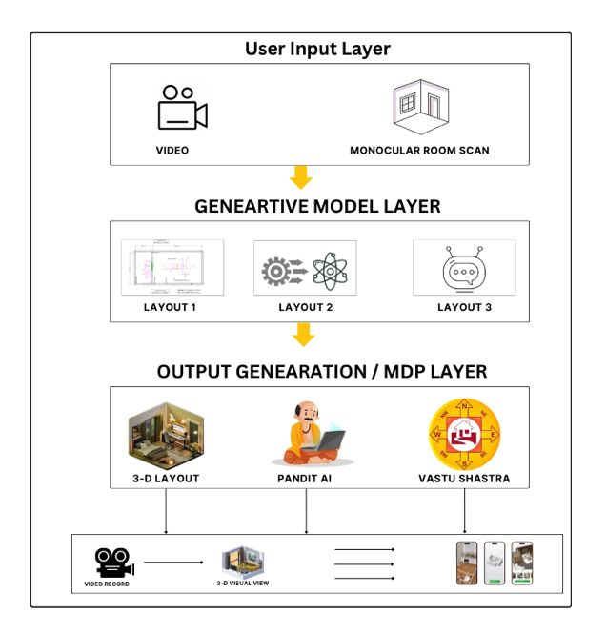
System architecture:

Slide 12
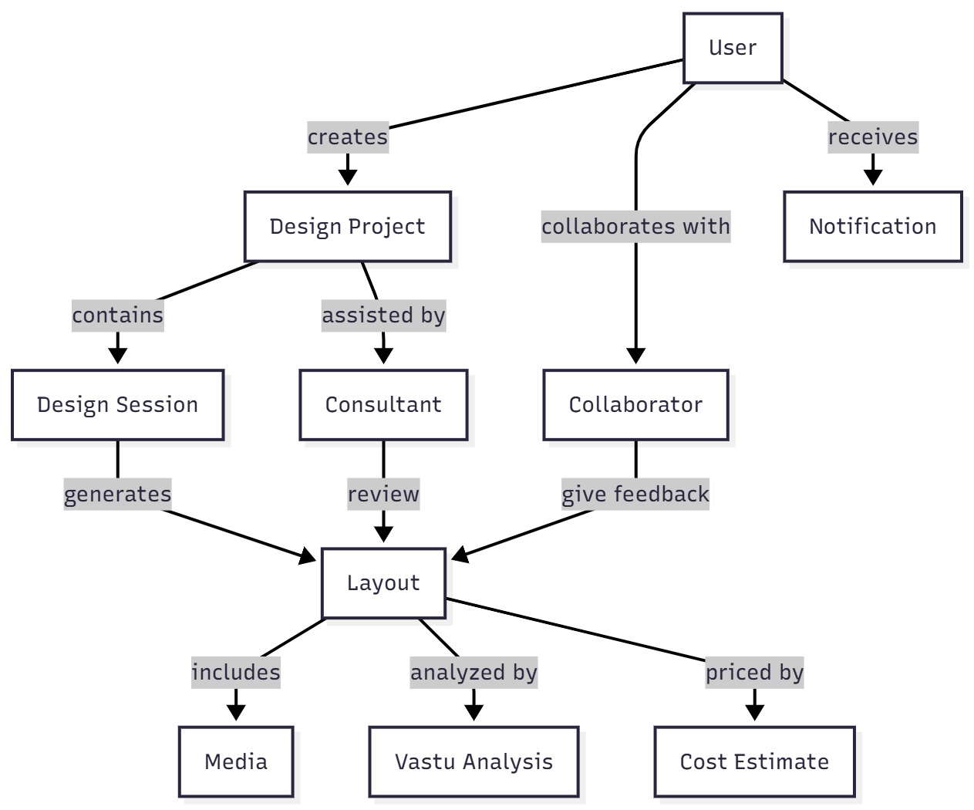
UML Diagram

Slide 13
Results and Discussion
• The MDP-based workflow improved user satisfaction by 5.1% while exploring only 5% of design possibilities.
• Demonstrated significant reduction in design time and computational effort.
• Outperformed random and rule-based design approaches.
• Effective perception-decision-action cycle validated through experiments with 20 participants.
• MDP provides optimal decisions through probabilistic state transitions and expected rewards.

Slide 14
Applications:
• Automated interior design optimization.
AI-driven building information modeling (BIM) enhancement.
Architecture and civil engineering project planning.
Smart home and adaptive environment design.
Virtual and augmented reality-based design simulation.
Education and training in computational design automation.

Slide 15
Advantages:
Reduces manual intervention in design decisions.
Learns from user feedback to improve satisfaction.
Probabilistic decision modeling ensures flexibility.
Scalable and adaptable for various environments.
Limitations
Requires significant computational resources for simulation.
Dependent on quality of input video data.
Partial automation; manual intervention still needed for complex objects.

Slide 16
References:
E. Karan et al., “A Markov Decision Process Workflow for Automating Interior Design,” International Journal of Building Information Modeling and Automation, vol. 5, no. 3, pp. 112–119, 2021.
K. Thakkar, S. Patel, and P. Shah, “Generative AI-Based Interior Designing,” International Journal of Innovative Research in Computer and Communication Engineering (IJIRCCE), vol. 12, no. 4, pp. 45–52, 2024.
M. Tumengkol et al., “AI Technology for Optimizing Real-Time Work Processes in Interior Design,” IEEE Access, vol. 12, pp. 21560–21572, 2024.
N. Hafizah, M. S. Rahman, and A. Karim, “The Role of Artificial Intelligence (AI) in Interior Architecture Design: A Thematic Review,” Journal of Interior Architecture and Design Studies, vol. 9, no. 1, pp. 13–28, 2025.
C. S. Dewi, R. M. Wijaya, and A. Gunawan, “Smart Interior Design System Leveraging Machine Learning and Augmented Reality for Personalization,” International Journal of Interactive Design and Manufacturing, vol. 11, no. 2, pp. 87–96, 2025.

Slide 17
ANEXURE:
ControlNet & Stable Diffusion: These are smart computer programs that can create and change pictures of rooms and furniture based on what you show or tell them. Think of them like digital artists who help design your space.
Markov Decision Process (MDP): This is a way for the computer to make step-by-step choices to find the best way to arrange your room, like planning moves in a game to get the best result.
Pandit Chatbot: This is a virtual helper that talks with you and answers questions about Vastu — the traditional Indian rules about how rooms should be arranged for good energy.

Slide 18
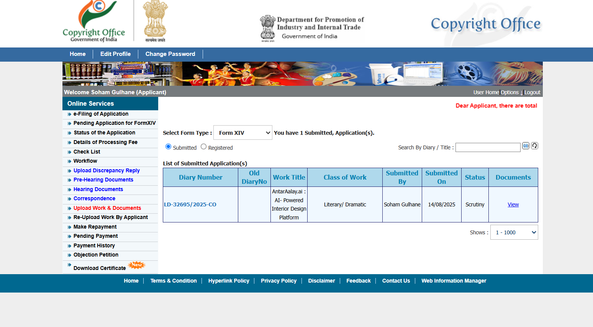
Copyright Details (Certificate/ Status Screenshot)

Slide 19
Paper Submitted Details (Journal/Conference Details, Submitted Date)
https://docs.google.com/document/d/1WrZSIBbaqvhCfqKtcxTwLPfHRy0nFjZz/edit?usp=drivesdk&ouid=115637726928041618657&rtpof=true&sd=true

Slide 20
Thank You!

Slide 21
Q&A……

